Slide 1

Stats 3
General Linear Models

Slide 2
General Linear Models
So we looked at what happens when we want to compare two sets of data to see if there is a relationship between them.
But what happens if our data isn’t normal?

Slide 3
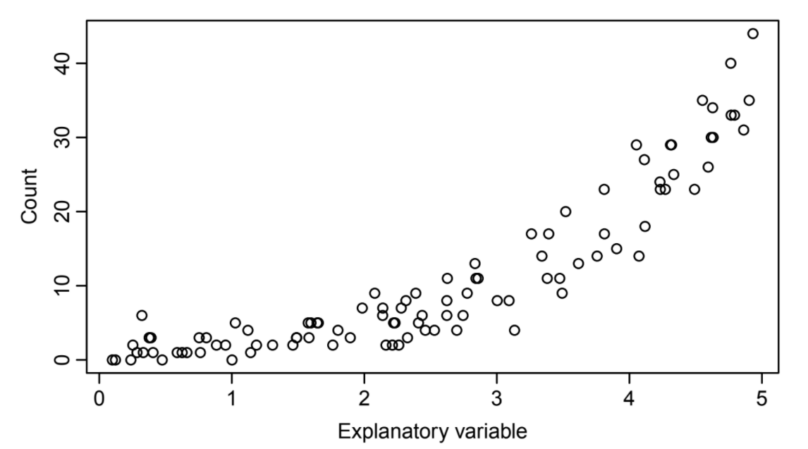
General Linear Models
The classic example of data that doesn’t follow traditional normal linear patterns is count data:
Number of fossils, number of parasites, number of sunny days etc

Slide 4
General Linear Models
If we look at count data that takes this shape

Slide 5
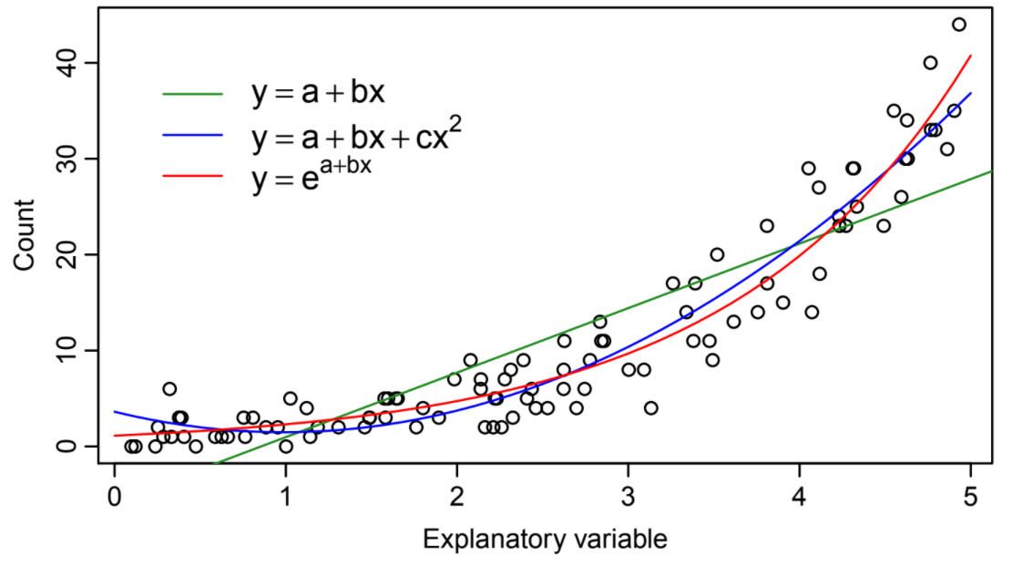
General Linear Models
And fit some lines to it

Slide 6
General Linear Models
We can see that an exponential curve actually fits this better.
But that’s not a straight line and we need one to match our linear assumptions.
So how can we get there?

Slide 7
General Linear Models
We can see that an exponential curve actually fits this better.
But that’s not a straight line and we need one to match our linear assumptions.
So how can we get there?

Slide 8
General Linear Models
We can see that an exponential curve actually fits this better.
But that’s not a straight line and we need one to match our linear assumptions.
So how can we get there?

Slide 9
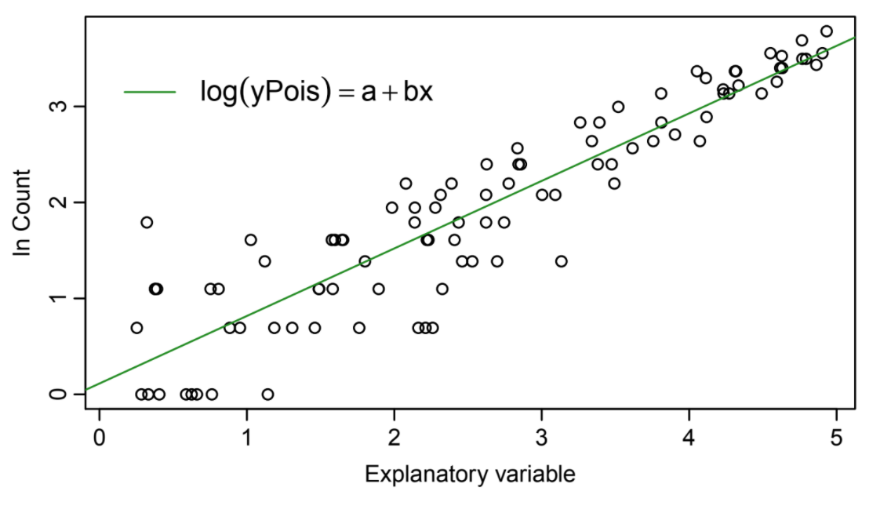
General Linear Models
So how can we get there?

Slide 10
General Linear Models
Well log looks better

Slide 11
General Linear Models
Well log looks better, but in reality this means our higher weighted points are having a higher effect on the overall pattern!
And any 0s are being
excluded as you can’t log 0

Slide 12
General Linear Models
Well log looks better, but in reality this means our higher weighted points are having a higher effect on the overall pattern!
And any 0s are being excluded as you can’t log 0.
This is why you shouldn’t transform your data!

Slide 13
General Linear Models
So if we don’t want to transform our data what do we want to do?
Well the assumptions of the models are normal distribution of error.
And our count data doesn’t have that error distribution.
What should we do?

Slide 14
General Linear Models
Transform our error distribution of course!
This is what a GLM does, it provides a transformation of the residuals that match a transformed error distribution.
There are several families of GLM depending on the error distribution you need.

Slide 15
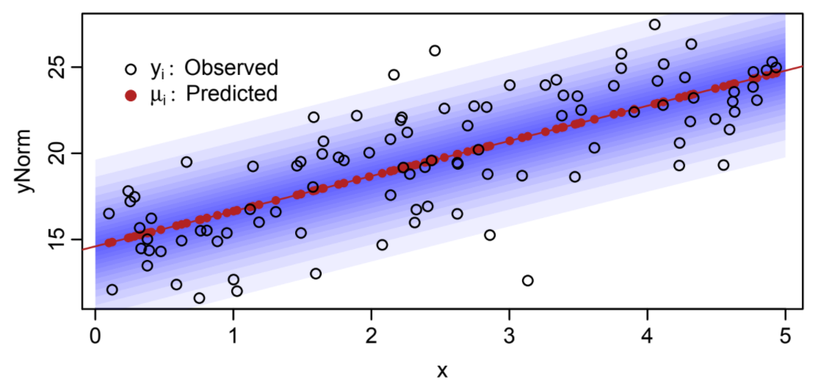
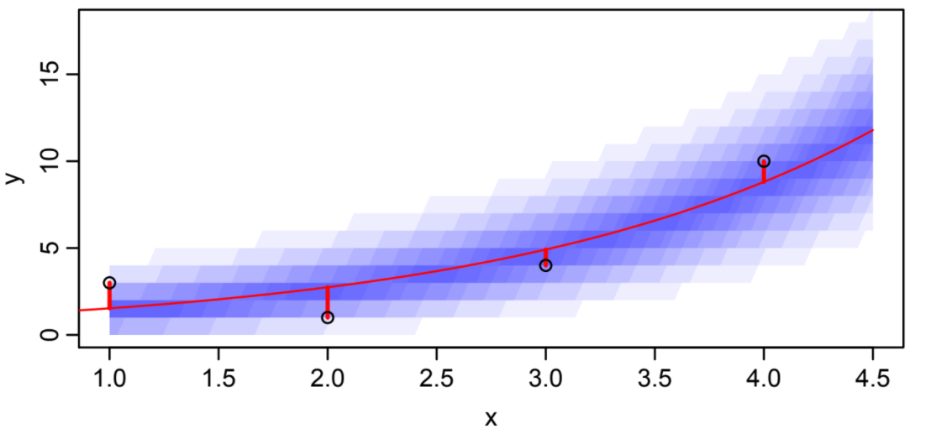
General Linear Models
The blue represents the error distribution of a normal LM on the left and of the poisson family on the right

Slide 16
GLM Families
Generally speaking you will know which GLM family to use based on the kind of data you have.
If it is count data it is best to use a poisson error distribution.
If it is yes or no survey data/presence absence etc use a binomial error distribution

Slide 17
GLM Families
There are also families which are called quassi
There is a quassipoisson and quassibionomial.
These are similar transformations of the error distribution but are more tolerant of changes in variance over time.
These exist but really shouldn’t be used, use a mixed effects model instead!

Slide 18
Comparing GLMs
GLMs are incredibly useful tools when doing statistical analysis, capable of handling a variety of data and doing a variety of things.
How about when we again need to compare between models?
Well GLMs work very similarly.

Slide 19
Comparing GLMs
GLMs are incredibly useful tools when doing statistical analysis, capable of handling a variety of data and doing a variety of things.
How about when we again need to compare between models?
Well GLMs work very similarly.

Slide 20
Comparing GLMs
GLMs use residual sum of squares same as LMs but instead of likelihood they use logLikelihood.
They are compared using Deviance which is 2 x the difference in model likelihoods.
AIC scores can also be compared.

Slide 21
Post-Hoc Tests
So there are some issues when we do GLMs on a factor.
When we want to see the effect a factor has on a variable we can use a GLM.
But this only tells us the effect of the factor as a whole.
How about if we want to see if there are differences between levels of the factor?

Slide 22
Post-Hoc Tests
Well we can do post hoc tests.
These are further tests to the results of our model that give us more detail.
We have to remember that in general post hoc analysis is discouraged so you should go into a GLM with the aim of performing these tests not just decide to do them after.

Slide 23
Post-Hoc Tests
In the case of factors in a GLM we will generally do what is called a TUKEY test.
This is essentially a series of T tests done on the factor levels within a model to see which are significant.
This is a more accepted way of doing many T-tests and it causes slightly less problems with type I errors but they are still possible!

